Slide 1
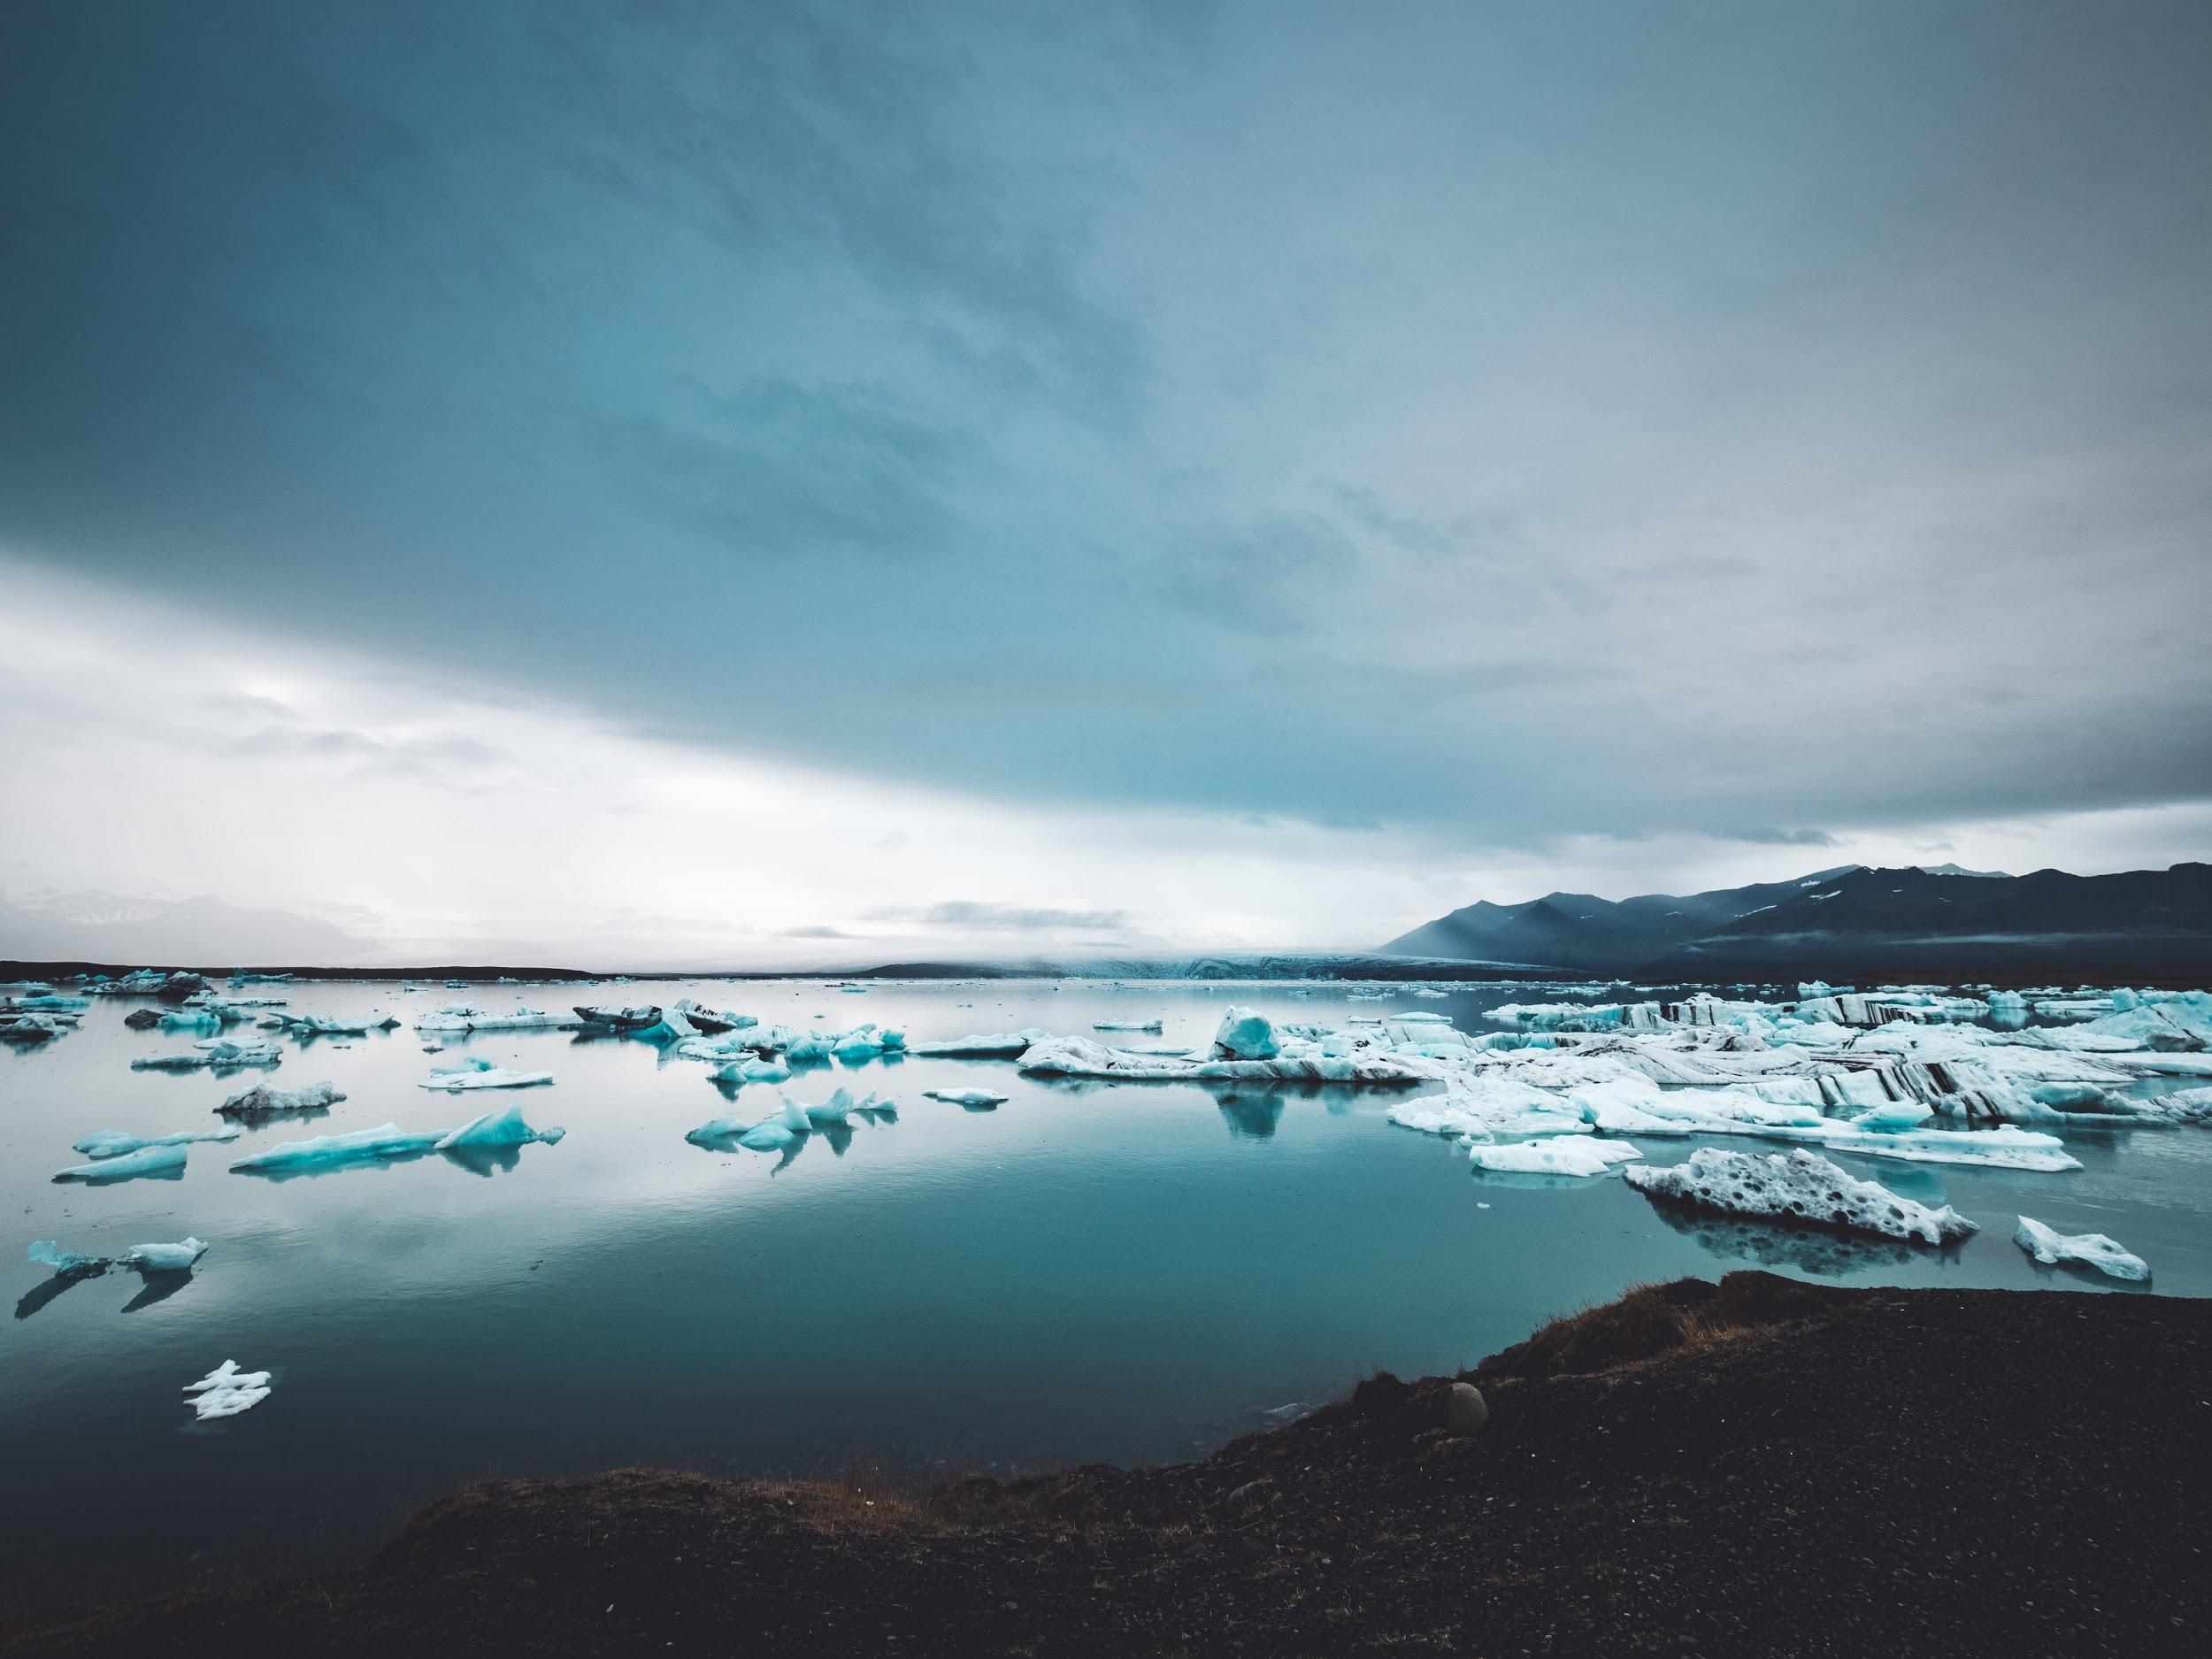
Introduction
to Climate Science
[Tribe Name] Community Climate Adaptation Workshop
[Weekday], [Month] [day], [year]
[Presenter’s Name]
Notes:
Welcome and thank you for attending this Tribal Community Gathering and Talking Circle.
I hope you will find this is an opportunity to learn more about climate change and to contribute your own knowledge and experience with us.
Our goal for today is to have a conversation about the climate concerns and needs of your community.
But first, I’d like to thank those who have made today possible and quickly provide you with an understanding of climate change and adaptation.
Citation:
Copyright-free photo by John Salvino on Unsplash

Slide 2
Effective presentations
Presentations are most effective when the audience feels connected to the presentation.
Include examples from your community or region.
Examples may include pictures or video clips of related events, problems, vulnerabilities, or instances of resiliency.
To cite any part of this presentation, please use the following citation:
Lefthand-Begay, C., Sanders, M., Sanchez, T., Watkinson, M., Pitt, P., & Grant, J. (2018). Introduction to climate science. In Tribal Community Gatherings and Talking Circle Protocol: A Guidebook for Hosting Community-based Workshops. Retrieved from https://claritalb.org/modules/
Notes:
This slide shouldn’t be included in the presentation, but is for the presenter.

Slide 3
Planning committee
[Member name], [Member work affiliation]
[Member name], [Member work affiliation]
[Member name], [Member work affiliation]
[Member name], [Member work affiliation]
Notes:
[Place the planning committee member names and their affiliations on this slide]
Thank you to the planning committee, who has worked together to design this community-based gathering in support of [community’s name] efforts to address climate change.
[If desired, list the names and specific contributions of members. Remember, acknowledgments will also be made at the end of the day.]

Slide 4
Contributing members
[Contributor’s name], [Contributor’s affiliation]
  Opening prayer and ceremony
[Contributor’s name], [Contributor’s affiliation]
  Homemade traditional lunch
[Contributor’s name], [Contributor’s affiliation]
  Speaker
[Contributor’s name], [Contributor’s affiliation]
  Sponsor
Notes:
[Place on this slide the names and affiliations of people who have contributed to the gathering outside of the planning committee members. Recognize specifically what they contributed.]
Thank you also to those who have contributed to this gathering in other ways. We could not do this without your knowledge, support, and generosity.
I apologize if I left anyone’s name off this list. If I did, please let me know during lunch so we can make sure to acknowledge your contributions.

Slide 5
Schedule
5-5:30 p.m.: Opening prayer
5:30-6 p.m.: [Presenter name]: An introduction to climate science
6-6:30 p.m.: [Presenter name]: Local examples of adaptation strategies
6:30-6:45 p.m.: Break and food
6:45-7:15 p.m.: Working dinner and group discussion about local climate concerns important to the [name of tribal community]
7:20 p.m.: Raffle
Notes:
[Place an image of your agenda on this slide.]
Here is the agenda for the day.
Thank you for welcoming us, [opening prayer contributor’s name here].
I’m starting us off with a presentation to give an Introduction to Climate Science.
We will then have [presenter name] present about [second presentation], followed by [presenter name] sharing [third presentation].
After the presentations, we will break to serve dinner and then come together to have a discussion about local climate concerns important to [name of tribal community].
Be sure to stick around for the raffle at the end of the gathering.

Slide 6

I can explain what is causing climate change.
I can explain how today’s climate is different from historical trends.
I can give examples of how climate change is affecting the Earth.
I can discuss “what makes my community most RESILIENT to the impacts of climate change.”
Learning objectives
Notes:
It is important to start off by setting goals for this meeting. By the end of this presentation, there are four main ideas you should remember.
You should be able to explain
What is causing climate change
How today’s climate is different from what we’ve seen throughout history
Examples of how climate change is affecting the Earth
What makes your community resilient or able to remain strong despite climate change .
This presentation, about 50 minutes, will focus on providing a broad explanation of greenhouse gas emissions, their effect on climate change, and general impacts of climate change on the environment and people, including sea level rise, increased flooding, human health, and the loss of cultural and natural resources. The presentation will end with an explanation and examples of climate resiliency.
I will leave about 10 minutes at the end of the presentation for questions and answers.
Citations:
Copyright-free photo from TeroVesalainen at https://pixabay.com/en/mindmap-brainstorm-idea-innovation-2123973/

Slide 7

The IPCC Synthesis Report
Who they are:
195 scientists from countries around the world who volunteer their time
Key messages:
Humans influence the climate system.
More disruption to our climate means more severe impacts.
We have the ability to limit climate change.
Notes:
Around the world, there is growing understanding of climate change and the need for immediate attention to help develop climate change policy.
There are many groups that focus on climate change, but one of the biggest is called the Intergovernmental Panel on Climate Change (IPCC).
These are hundreds of scientists from around the world who study and review scientific, technical, and socio-economic (HELP) information related to global climate change.
They are internationally recognized and advise many world leaders on problems and solutions surrounding climate change.
While early debates focused on mitigation or interventions to reduce greenhouse gases, the concept of adaptation to climate change has also become important.
The key message is that there is important evidence that humans influence climate change.
Additionally, the more we disrupt our climate, the greater the risks and impacts will be.
However, humans do have the knowledge, tools, and means to limit the continuation of climate change.
Citations:
IPCC (2014). Climate change 2014: Synthesis report. Contribution of working groups I, II and III to the fifth assessment report of the Intergovernmental Panel on Climate Change.
Copyright-free photo by Evan Dennis on Unsplash

Slide 8
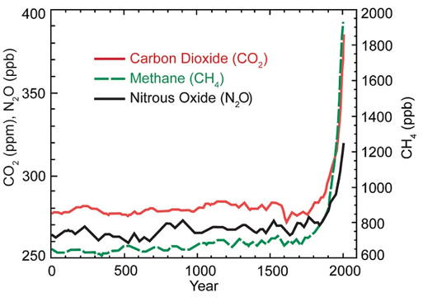
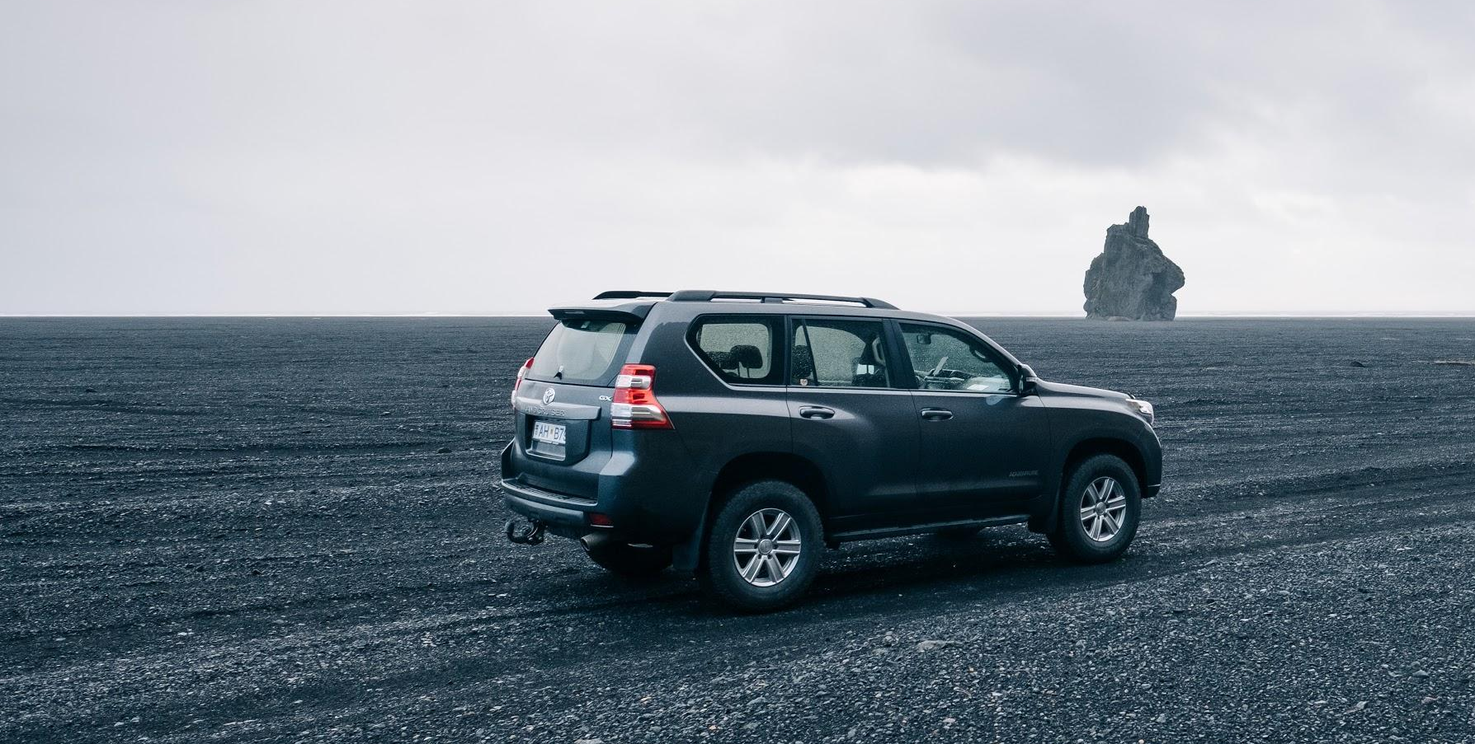
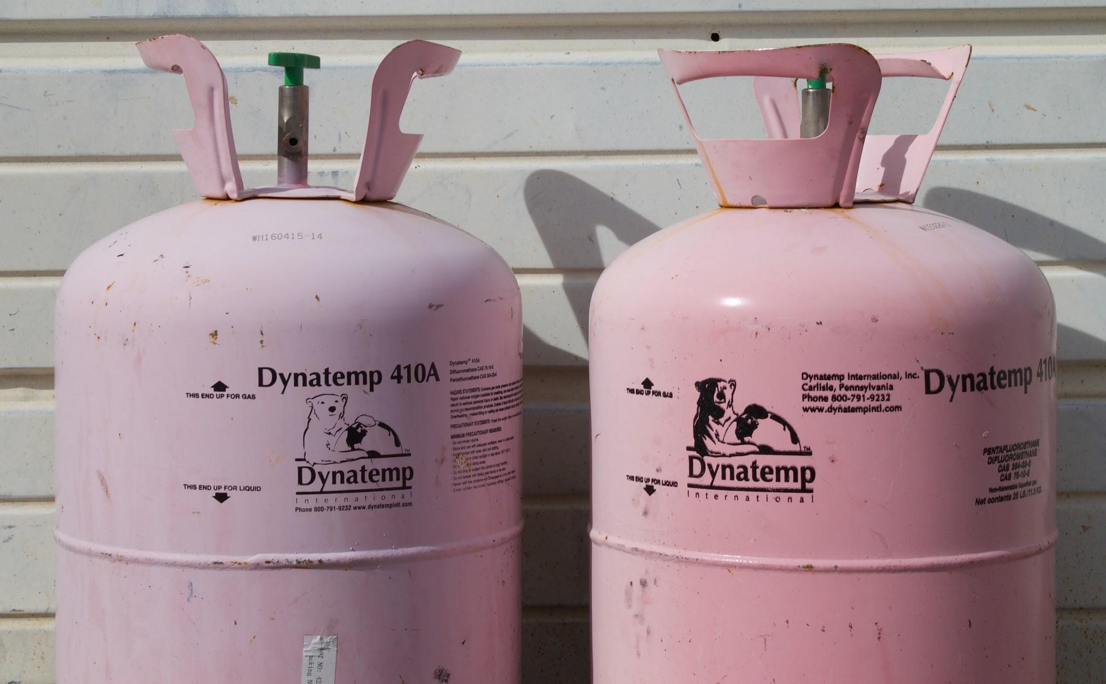
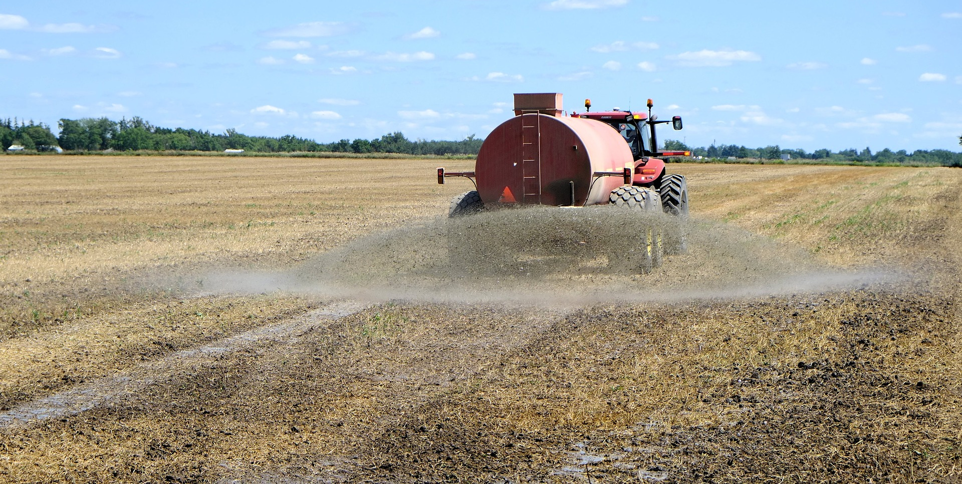
Driving force of climate change
Notes:
This graphic shows the large increase in greenhouse gas emissions since the industrial revolution in the 1700s and 1800s.
Greenhouse gas emissions are both natural and human created.
The red line is carbon dioxide. (Naturally it comes from decomposition. Humans produce it when they burn gas and oil.)
The green line is methane. (It is produced when coal or natural gas burns.)
The black line is nitrous oxide (It is produced naturally after lightning strikes and by humans when dealing with agriculture and fertilizers.)
The extra human-created greenhouse gases stay in our atmosphere and contribute heavily to climate change.
The increase in human-induced greenhouse gas emissions has led to anthropogenic (an-thro-po-gen-ic) climate change, which means the changes we’re seeing are caused by humans, not just normal environment changes.
Citations:
Karl, Thomas R., Melillo, Jerry M., & Peterson, Thomas C. (Eds.). (2009). Global climate change impacts in the United States. Cambridge University Press.
Copyright-free photo by Jonathan Percy on Unsplash
Copyright-free photo by Marra Sherrier on Unsplash
Copyright-free photo by pixel 1 from https://pixabay.com/en/hydrogen-sulfide-fertilizer-spray-905243/

Slide 9
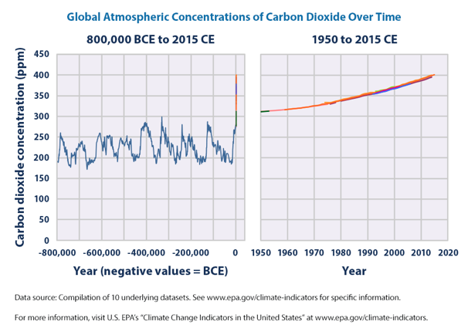
Unprecedented recent CO₂ concentrations
Notes:
Another greenhouse gas is carbon dioxide.
Naturally, the amount of carbon (in the air) cycles through different levels over time, as you can see in the first graph.
PPM stands for parts per million, and you can see that historically, the carbon dioxide concentration was never higher than 300 parts per million.
However, today’s atmospheric concentrations are higher than any known through history.
The levels around 2015 were 400 parts per million.
These may not seem like large changes, but even small changes can have big effects on the environment.
The amounts of carbon from thousands of years ago are found using geology and measuring carbon concentrations frozen in Antarctica.

Slide 10
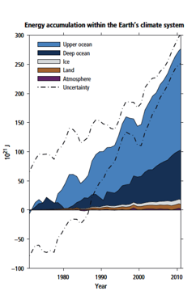
Ocean temperatures
The ocean absorbs most of the heat trapped in the atmosphere.
Land temperatures and ocean temperatures continue to climb.
Notes:
Gases in the atmosphere are one part of the world that is affected by human-caused climate change, but the oceans are impacted too.
The ocean absorbs most of the heat trapped in the atmosphere.
More than 90 percent of the energy circulating in the climate system (land, air, and water) from 1971 to 2010 has ended up in the ocean.
This means ocean temperatures continue to rise, while land temperatures remain at historic highs.
The ocean also absorbs much of the extra carbon dioxide. We used to believe this was a good thing because it meant that it was not being absorbed into the atmosphere. However, the increase in carbon dioxide in the ocean causes harm for many species living in the ocean through a change in temperature and pH.
Citation:
IPCC. (2014). Climate change 2014: Synthesis report. In L.A. Meyer & R.K. Pachauri (Eds.), Contribution of working groups I, II and III to the fifth assessment report of the Intergovernmental Panel on Climate Change. Geneva, Switzerland: IPCC.

Slide 11
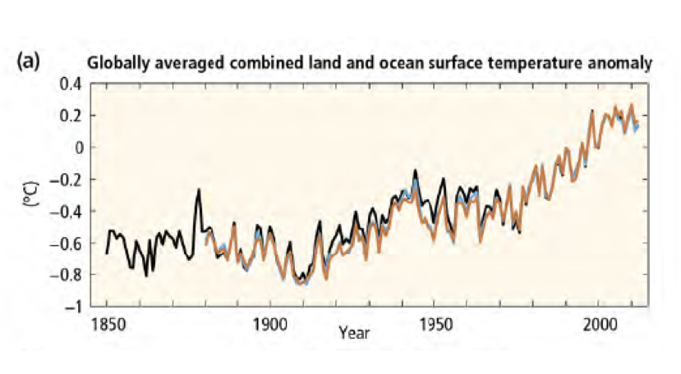
Notes:
Here is another graph. This one shows the combined temperatures of land and oceans. The black, blue, and orange lines show temperatures collected by different groups in different data sets. All of them reflect the same changes.
As you can see, cycles and changes over time are normal, but the overall temperature continues to rise beyond what we would expect to happen naturally.
Citation:
IPCC. (2014). Climate change 2014: Synthesis report. In L.A. Meyer & R.K. Pachauri (Eds.), Contribution of working groups I, II and III to the fifth assessment report of the Intergovernmental Panel on Climate Change. Geneva, Switzerland: IPCC.

Slide 12
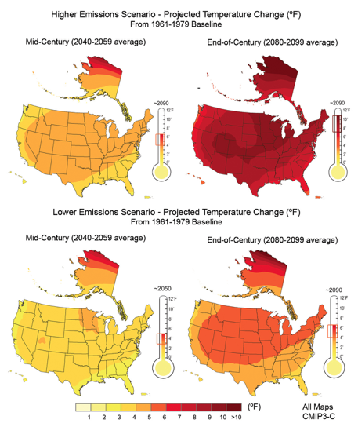
Notes:
As we continue to produce greenhouse gases, temperatures are projected to increase between 1 and 12 degrees Fahrenheit.
These maps were produced by the U.S. Global Research Change Program in a report to advise U.S. regions on how global climate change will impact them locally.
The left two maps show average predictions for the middle of the century (2040 to 2059), and the right two maps show predictions for the end of the century (2050 to 2099).
The top maps also show higher emissions (greenhouse gases), while the bottom maps show lower emissions.
The projected temperature change varies depending on how much greenhouse gas we continue to produce, and every region will experience different levels of rising temperatures.
These projected temperature changes may not seem like a lot, but they can have huge effects on everything from weather patterns to plants, animals, and humans.
Citation:
Karl, Thomas R., Melillo, Jerry M., & Peterson, Thomas C. (Eds.). (2009). Global climate change impacts in the United States. Cambridge University Press.

Slide 13
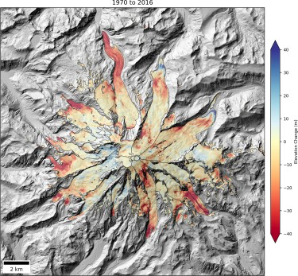
Climate change challenges
Melting arctic ice
Decrease in glacier sizes
  Example: Mt. Rainier lost 130 feet of ice in certain areas between 1970 and 2016.
Notes:
We have now finished the first part of our presentation on what is causing climate change and how the trends are different from natural cycles we’ve seen in the past.
Now that we know what is causing it, we need to look at the impacts and challenges that come with climate change.
First, melting arctic ice and decreasing glacier sizes are a direct effect of higher temperatures.
This map shows the elevation change of Mount Rainier glaciers between 1970 and 2016.
The earlier observations are from United States Geological Survey (USGS) maps, while the recent data use information from satellites.
In some places, we can see that glacier surface elevations have dropped more than 40 meters (or 130 feet).
Citation:
Shean, David (Cartographer). (n.d.). Mount Rainier glacial elevation changes. Reprinted from Mountain glaciers shrinking across the west. UW News. Retrieved October 20, 2017, from http://www.washington.edu/news/2017/10/20/mountain-glaciers-shrinking-across-the-west/?utm_source=UW+News+Subscribers&utm_campaign=aaf4144c3c-UW_Today_Monday_October_23_2017&utm_medium=email&utm_term=0_0707cbc3f9-aaf4144c3c-308921997

Slide 14
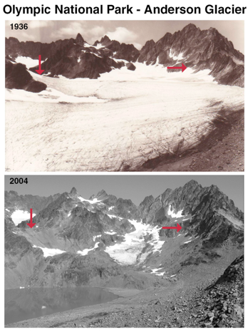
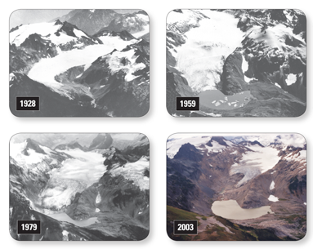
Left: Anderson Glacier
Above: Retreat of South Cascade Glacier
Notes:
The most recent and obvious impact of rising temperatures in the Pacific Northwest is the shrinking of the glaciers (Olympics, Mt. Anderson) and the high increase in melting snow pack.
This shrinking not only alters the landscape, but also has a large impact on river flows and temperature.
Melting glaciers also contribute to rising sea levels but at a much lower rate than other factors contributing to sea level rise.
The two images on the left show comparisons over time of the Anderson Glacier. The red arrows pointing to the exact same locations in both photos show the glacial loss.
The other four images show the loss of the South Cascade Glacier from 1928 to 2003.
Citations:
Retreat of South Cascade Glacier [photographs]. (2016). Retrieved August 13, 2018 from https://pubs.usgs.gov/fs/2009/3046/
Adams, B., & Curtis, A. (2018). Comparison of Anderson Glacier [photographs]. Retrieved August 13, 2018 from https://www.nps.gov/olym/learn/nature/glaciers.htm

Slide 15
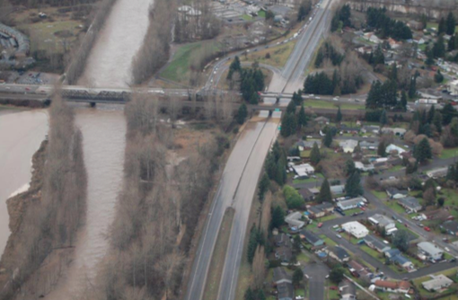
Climate change challenges
Coastal flooding
Erosion
Warming oceans
Rising sea levels
Notes:
Glaciers are not the only thing affected by climate change.
Globally, climate change will cause weather extremes, such as floods.
Rising sea levels and coastal flooding have already been observed in some regions and are expected to become more frequent.
Some areas will experience an increase in coastal erosion and oceans will continue to become warmer.
Citation:
Puyallup Tribe of Indians. (2016). Climate change impact assessment and adaptation options. A collaboration of the Puyallup Tribe of Indians and Cascadia Consulting Group.

Slide 16
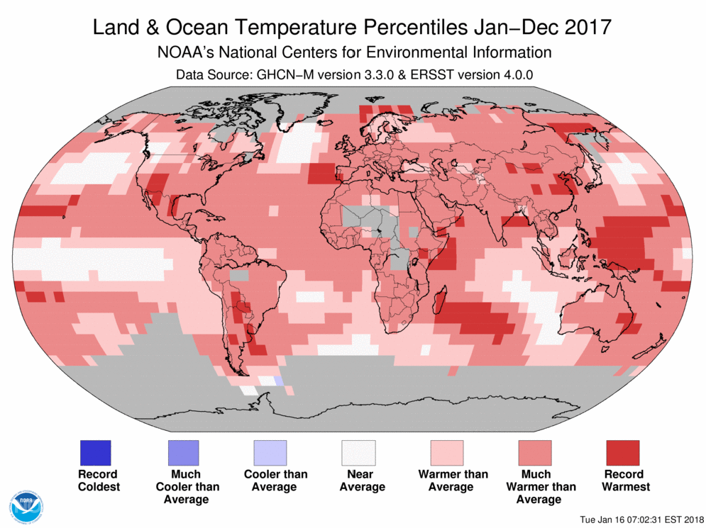
Climate change challenges
Notes:
Those warmer waters – along with rising seas, coastal droughts, and ocean acidification – are already putting animals, plants, and people at risk.
According to NASA and the National Oceanic and Atmospheric Administration (NOAA), 2017 was the third-hottest year globally, with 2015 being the second-hottest year and 2016 being the hottest year.
Citation:
NOAA: 2017 was 3rd warmest year on record for the globe. (2018, January). NOAA. Retrieved August 13, 2018 from http://www.noaa.gov/news/noaa-2017-was-3rd-warmest-year-on-record-for-globe

Slide 17
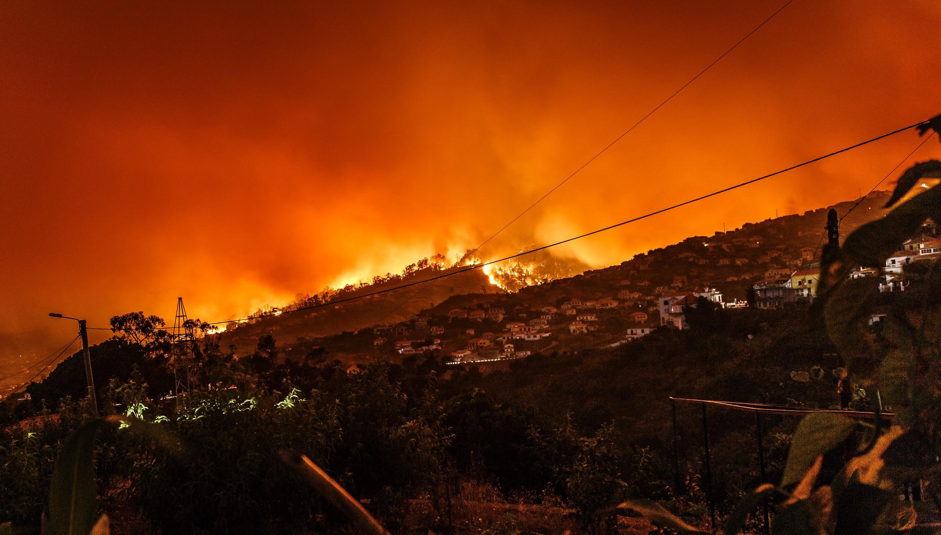
Climate change challenges
Wildfires
Droughts
Habitat loss
Notes:
Additionally, extreme heat will lead to increased frequency and severity of wildfires and drought.
As a result of fires, drought, flooding, and diseases, Mother Earth will experience an increase in habitat loss.
Adaptations can be made though
Open space around structures,
Restoration of lands, as fires are more catastrophic and longer lasting than historic fires,
Attention to ecosystems (sometimes initial responses to burned areas focus on the commercial value of trees (due to their commercial value), rather than on how the ecosystem functions or how fish and wildlife are supported).
Citation:
Copyright-free photo by Michael Held on Unsplash

Slide 18
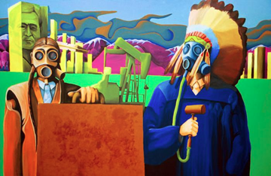
Human health
“Climate change leads to more intense heat waves, more particulates from wildfires clouding the atmosphere, longer allergy seasons and, in turn, more asthma attacks.”
— Former Surgeon General Vivek H. Murthy, M.D.
Notes:
Human health can also be affected by climate change. Heat waves and air pollution both have negative impacts on human health.
Low-income and minority families are more likely to have someone with asthma.
It is important for these environmental triggers to be limited to manage asthma.
We will cover human health in more detail later in this presentation.
Citations:
Echo-Hawk, B. (2013). Just a regular guy named Bucky Echo-Hawk [artwork]. Retrieved August 13, 2018, from https://chicagotonight.wttw.com/2013/09/25/just-regular-guy-named-bunky-echo-hawk
EPAgov. (2015). EPAgov [online quote with image]. Retrieved August 13, 2018 from https://www.instagram.com/p/5unIUVgpQQ/?taken-by=epagov

Slide 19
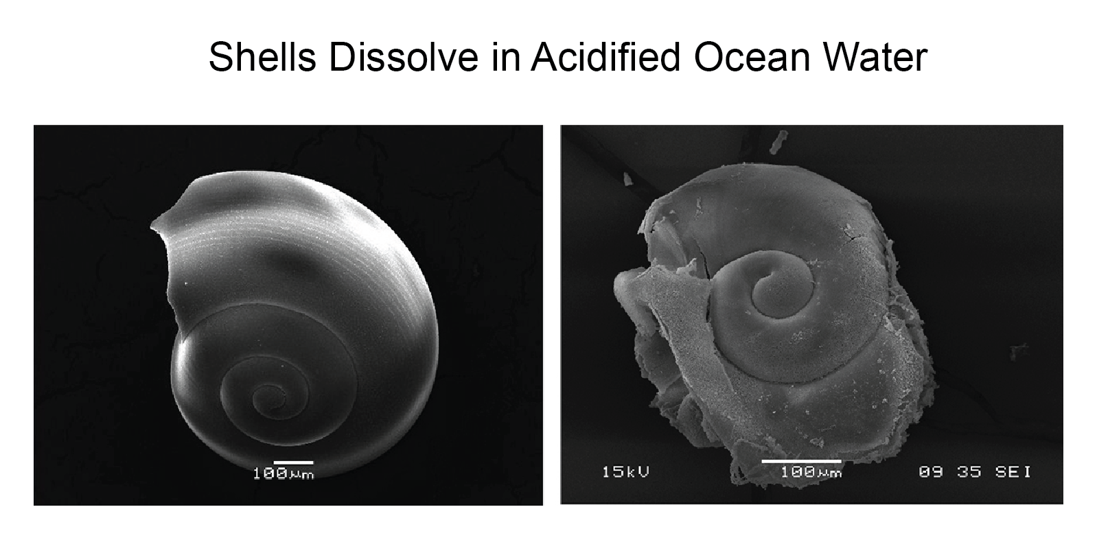
Ocean acidification
Decline of first foods for many tribes
  Clams and oysters unable to produce a healthy shell to grow
Reduction of economic opportunity
  Loss to shellfish industry
Changes in the marine ecosystem
  Can reduce food for salmon, seabirds, and other marine wildlife
Notes:
[These slides contain information specific to the Pacific Northwest and tribes there. Please modify them as necessary to fit with your region and tribal experiences.]
In addition to the impacts on human health, many Pacific Northwest tribes face environmental problems due to ocean acidification, rising sea levels, and declining salmon habitat.
Ocean acidification can cause a decline in foods for many NW tribes, including clams and oysters. This is because many shellfish are unable to produce a healthy shell to grow in higher pH levels.
On the right side of this slide, there is an example of a healthy shell compared with a shell in ocean water having a higher acidic level.
A loss of shellfish can lead to a reduction of economic opportunity, as several Washington tribes depend on the shellfish industry for their economies.
Additionally, ocean acidification can have a large impact on the marine ecosystem, including reducing food for salmon, seabirds, and other marine wildlife.
Citation:
Bednaršek, Nina. (Photographer). (2012). Shells dissolve in acidified ocean water [photograph]. Retrieved from https://nca2014.globalchange.gov/report/our-changing-climate/ocean-acidification

Slide 20
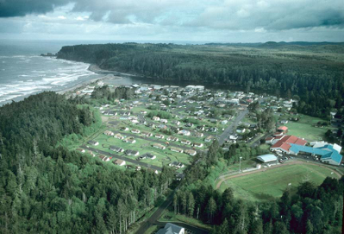
Sea level rise –
Quinault Indian Nation
Problem:
  Sea level rise, coastal erosion, and flooding
Adaptation strategy:
  Relocate community to higher ground
Notes:
[These slides contain information specific to the Pacific Northwest and tribes there. Please modify them as necessary to fit with your region and tribal experiences.]
Here is another example of people impacted by climate change.
The majority of Quinault Indian Nation (QIN) community members live in Taholah, a small town right off the coast and at the mouth of the Quinault River in Washington.
Because of the community’s location on the coast, QIN is projected to face increased sea levels, and due to increased flooding and coastal erosion, the lower village of Taholah continues to face problems.
QIN is planning to relocate this community from the lower village to the upper village, a location that is near the lower village, but about 150 feet higher in elevation. The infrastructure that is being relocated includes the school, community and senior center, administrative buildings, and residential homes.
Citation:
Quinault Indian Nation’s village of Taholah [online image]. (2016). Retrieved August 13, 2018 from https://www.climate.gov/news-features/climate-case-studies/quinault-indian-nation-plans-village-relocation

Slide 21
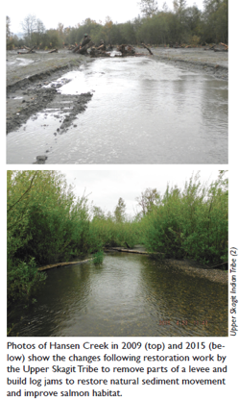
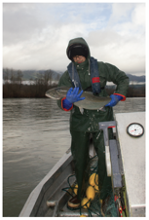
Salmon habitat
Urbanization and land-use change are major contributors to
  Loss of habitats
  Sedimentation
  Water quality impairments
Notes:
[These slides contain information specific to the Pacific Northwest and tribes there. Please modify them as necessary to fit with your region and tribal experiences.]
Many tribes in the Pacific Northwest are being affected by climate change and the declining salmon population. This decline is due to a decrease in salmon habitat, sedimentation, and poor water quality.
One contribution to poor salmon habitat is the decline in snowpack in the glacial mountains as a result of increased temperatures, which was mentioned earlier.
This means that during the warmer months, there is less cold water for salmon to thrive in.
Individual tribes and tribal groups are working toward creating salmon recovery plans, such as the Skagit Chinook Recovery Plan, to address the decline in salmon populations through restoration and log jams.
Citation:
Tribes of Western Washington. Northwest Indian Fisheries Commission. (2016). 2016 state of our watersheds: A report by the Treaty Tribes of Western Washington. Retrieved from https://geo.nwifc.org/SOW/SOW2016_Report/SOW2016.pdf

Slide 22
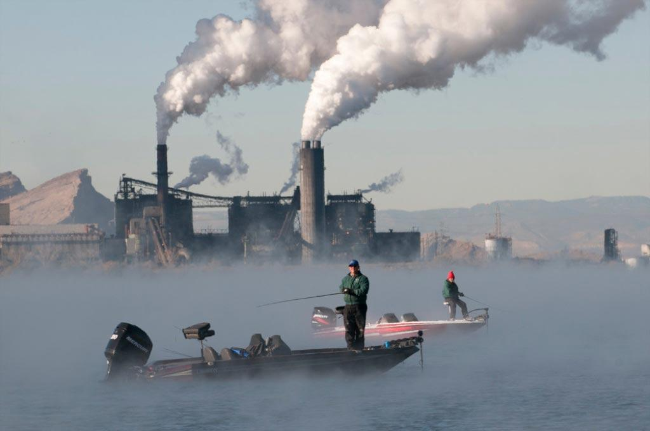
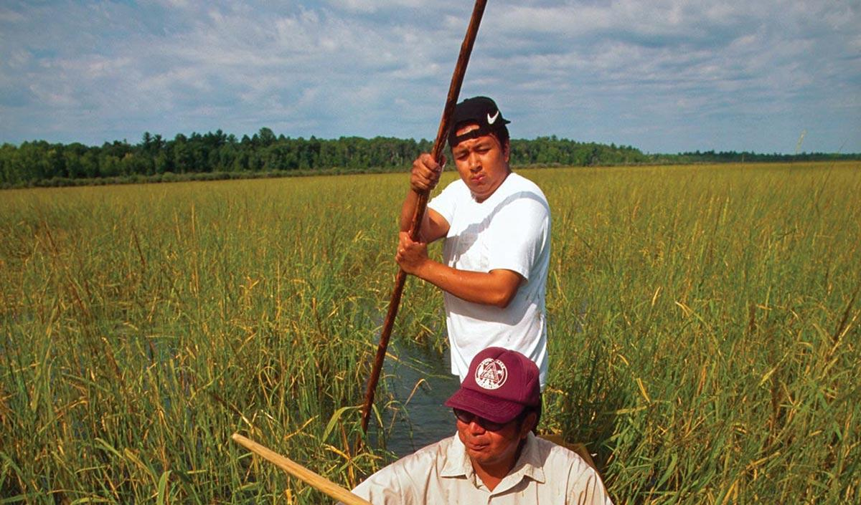
Review of climate change impacts
Environment
and ecosystems
Warming of ocean waters
Reduction of glaciers and snowpack
Ocean acidification
Shifting or dying of species
Agriculture and foods
Threats to Tribal food security
Low yields
Changes to biodiversity
Fresh water
Threats to Tribal water security
Flooding
Droughts
Notes:
Here is a summary of some of the impacts and challenges from climate change that we covered in this presentation.
There are many other examples and areas of climate change that have not been discussed here.
Some additional things to consider specific to our tribal communities are food and water security, particularly as many communities use food and water not only for our basic needs, but also for cultural and ceremonial use, including restoration, or to support culturally important species.
Communities need to be able to withstand extremes as they think about future development, and some tribal communities may already be lacking proper infrastructure. Solutions need to be long term, which makes them less politically popular.
Citation:
Melillo, Jerry M., Richmond, Terese (T.C.), & Yohe, Gary W. (Eds.). (2014). Climate change impacts in the United States: The third national climate assessment. Retrieved from National Climate Assessment website: https://nca2014.globalchange.gov/downloads. doi:10.7930/J0Z31WJ2

Slide 23
Who will face the brunt of climate change?
Indigenous people and small island populations (IPCC, 2001)
There are concerns that low-income or poor people will fall deeper into poverty and face further livelihood problems (Eriksen and O’Brien, 2007).
Notes:
There is increasing evidence globally that poor and minority people, especially marginalized Indigenous people and small island populations, will face the brunt of negative climate change effects.
There are concerns that poor people will fall even deeper into poverty and face further livelihood problems.
Some researchers stress the importance of including indigenous people and their perspectives in the discussion of development issues, for reasons of equity and justice, their inclusion in adaptation policies.
Yet indigenous and poor people have often been marginalized in debates on climate change at the local, national, or international level – and to date there has been relatively little research on climate change adaptation that incorporates their perspectives

Slide 24
Tribal nations in the United States
566 federally recognized tribes
Many other non-federally recognized tribes
American Indian and Alaska Natives cover 4% of the land and composes less than 1% of the population
Notes:
[Please feel free to add your tribal logo or pictures representing tribes from your region here.]
As of 2010, the estimated population of American Indians and Alaska Natives was 2.9 million. They made up 0.9 percent of the total population.
The projected population of American Indians and Alaska Natives, including those of more than one race, on July 1, 2050, is 8.6 million. They would compose 2 percent of the total population.
As we continue to examine climate impacts and work toward addressing them in our communities, we need to recognize the indigenous populations and tribes that are uniquely affected by climate change.
Citation:
Infoplease (n.d.). Native Americans by the numbers. Retrieved from https://www.infoplease.com/american-indians-numbers-1#ixzz2aHBxno7q

Slide 25
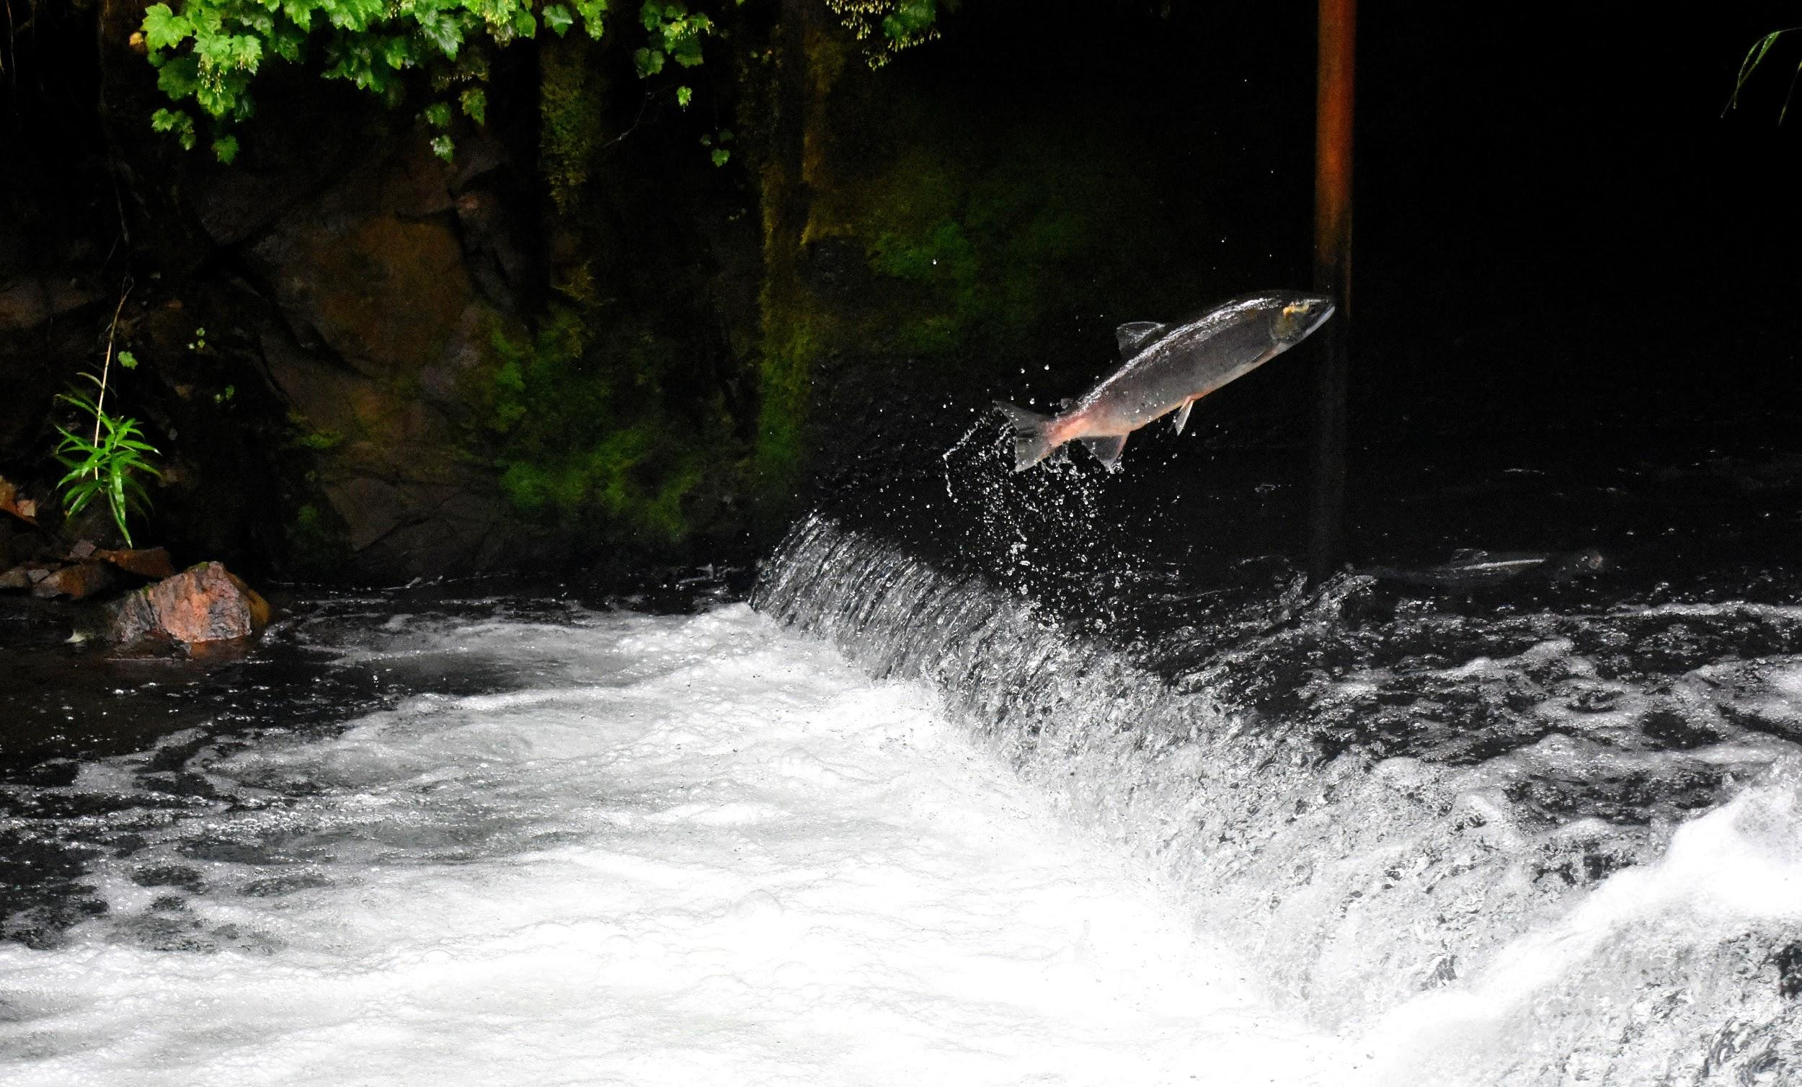
“Climate change is threatening the natural resources we have relied upon for centuries, as well as our health, economy, and infrastructure. For our people, climate change is no longer a ‘tomorrow’ issue—we must address this challenge now.”
— Bill Sterud, Puyallup Tribal Council Chairman
Notes:
Thank you for your time and attention. I hope this discussion has been informative and will spark discussions and movements in your own communities.
Thank you again to everyone who has made this possible.
Citations:
Puyallup Tribe of Indians. (2016). Climate change impact assessment and adaptation options. A collaboration of the Puyallup Tribe of Indians and Cascadia Consulting Group.
Copyright-free photo by Drew Farwell on Unsplash

Slide 26
References
Adams, B., & Curtis, A. (2018). Comparison of Anderson Glacier [photographs]. Retrieved August 13, 2018 from https://www.nps.gov/olym/learn/nature/glaciers.htm
Bednaršek, Nina. (Photographer). (2012). Shells dissolve in acidified ocean water [photograph]. Retrieved from https://nca2014.globalchange.gov/report/our-changing-climate/ocean-acidification
Echo-Hawk, B. (2013). Just a regular guy named Bucky Echo-Hawk [artwork]. Retrieved August 13, 2018, from https://chicagotonight.wttw.com/2013/09/25/just-regular-guy-named-bunky-echo-hawk
EPAgov. (2015). EPAgov [online quote with image]. Retrieved August 13, 2018 from https://www.instagram.com/p/5unIUVgpQQ/?taken-by=epagov

Slide 27
References
Infoplease (n.d.). Native Americans by the numbers. Retrieved from https://www.infoplease.com/american-indians-numbers-1#ixzz2aHBxno7q
IPCC. (2014). Climate change 2014: Synthesis report. In L.A. Meyer & R.K. Pachauri (Eds.), Contribution of working groups I, II and III to the fifth assessment report of the Intergovernmental Panel on Climate Change. Geneva, Switzerland: IPCC.
Karl, Thomas R., Melillo, Jerry M., & Peterson, Thomas C. (Eds.). (2009). Global climate change impacts in the United States. Cambridge University Press.
Melillo, Jerry M., Richmond, Terese (T.C.), & Yohe, Gary W. (Eds.). (2014). Climate change impacts in the United States: The third national climate assessment. Retrieved from National Climate Assessment website: https://nca2014.globalchange.gov/downloads. doi:10.7930/J0Z31WJ2

Slide 28
References
NOAA: 2017 was 3rd warmest year on record for the globe. (2018, January). NOAA. Retrieved August 13, 2018 from http://www.noaa.gov/news/noaa-2017-was-3rd-warmest-year-on-record-for-globe
Puyallup Tribe of Indians. (2016). Climate change impact assessment and adaptation options. A collaboration of the Puyallup Tribe of Indians and Cascadia Consulting Group.
Quinault Indian Nation’s village of Taholah [online image]. (2016). Retrieved August 13, 2018 from https://www.climate.gov/news-features/climate-case-studies/quinault-indian-nation-plans-village-relocation
Retreat of South Cascade Glacier [photographs]. (2016). Retrieved August 13, 2018 from https://pubs.usgs.gov/fs/2009/3046/

Slide 29
References
Shean, David (Cartographer). (n.d.). Mount Rainier glacial elevation changes. Reprinted from Mountain glaciers shrinking across the west. UW News. Retrieved October 20, 2017, from http://www.washington.edu/news/2017/10/20/mountain-glaciers-shrinking-across-the-west/?utm_source=UW+News+Subscribers&utm_campaign=aaf4144c3c-UW_Today_Monday_October_23_2017&utm_medium=email&utm_term=0_0707cbc3f9-aaf4144c3c-308921997
Tribes of Western Washington. Northwest Indian Fisheries Commission. (2016). 2016 state of our watersheds: A report by the Treaty Tribes of Western Washington. Retrieved from https://geo.nwifc.org/SOW/SOW2016_Report/SOW2016.pdf

