Slide 1
Climate Adaptation
[Tribe Name] Community Climate Adaptation Workshop
[Weekday], [Month] [Day], [Year]
[Start time] –[End time]
[Presenter’s Name]
Notes:
[Feel free to add your own local examples or pictures if they are relevant to the slides]
Welcome to our presentation on climate adaptation.

Slide 2
Effective presentations
Presentations are most effective when the audience feels connected to the presentation.
Include examples from your community or region.
Examples may include pictures or video clips of related events, problems, vulnerabilities, or instances of resiliency.
To cite any part of this presentation please use the following citation:
Lefthand-Begay, C., Sanders, M., Sanchez, T., Watkinson, M., Pitt, P., & Grant, J. (2018). Introduction to climate adapation. In Tribal Community Gatherings and Talking Circle Protocol: A Guidebook for Hosting Community-based Workshops. Retrieved from https://claritalb.org/modules/
Notes:
This slide shouldn’t be included in the presentation, but is for the presenter.

Slide 3
Learning outcomes
Explain the three overlapping factors that contribute to increased health risk.
Understand the difference between vulnerability and resilience.
Create a list of reasons your community is resilient and vulnerable.
Notes:
This presentation will go over these main points:
The three factors that when combined increase health risks,
The differences between labeling a community as vulnerable and resilient,
Ways your local community is vulnerable and resilient.

Slide 4
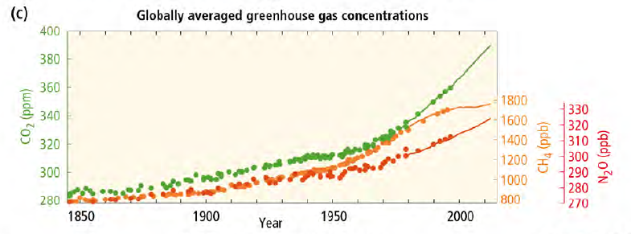
Health effects
Temperature-related illnesses and deaths
Health effects related to extreme weather events
Air pollution-related health effects
Water- and foodborne illnesses
Vector- and
rodent-carried diseases
Regional weather changes
Heat waves
Extreme weather
Temperature
Precipitation
Climate change
natural
AND
human-caused
Notes:
Remember, the increase in climate change that we see today is caused in part by the production of greenhouse gas emissions from human activities. We call this anthropogenic (an-thro-po-gen-ic) climate change.
The graph at the bottom left shows the increase in three greenhouse gases since the industrial revolution.
Due to climate change and regional weather changes, the health of humans, animals, and plants are all affected.
These health effects listed are only a sampling of potential health effects.
There can be temperature-related illnesses such as heat stroke.
Health effects from extreme weather, such as stress and anxiety, can manifest physically as well.
Air pollution creates problems with breathing and can worsen illnesses such as asthma.
Water can become contaminated and affect fish and other animals.
Vectors (organisms that spread disease, such as ticks or mosquitos) can spread rapidly.
Citations:
Patz, J. A., McGeehin, M. A., Bernard, S. M., Ebi, K. L., Epstein, P. R., Grambsch, A., … Trtanj, J. (2000). The potential health impacts of climate variability and change for the United States: executive summary of the report of the health sector of the U.S. National Assessment. Environmental Health Perspectives, 108(4), 367–376.
Dalton, M., Mote, P.W., & Snover, A.K. (Eds.) (2013). Climate change in the Northwest: Implications for our landscapes, waters, and communities. Washington, D.C.: Island Press.

Slide 5
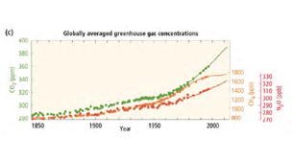
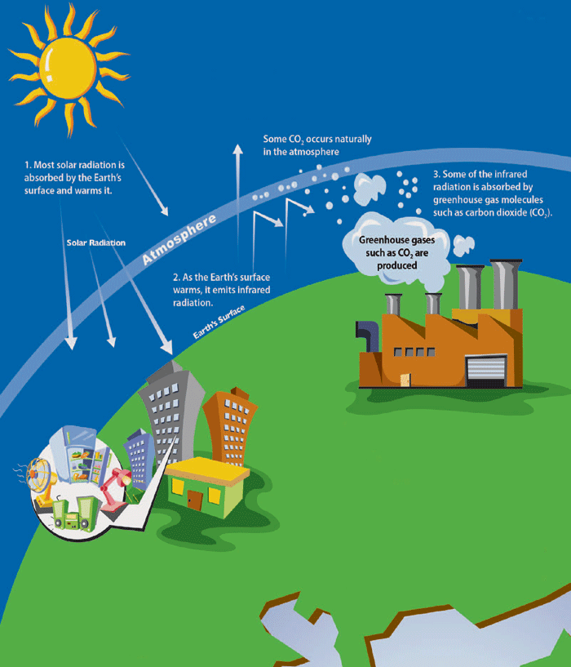
Key takeaways
Human influence on the climate system is clear.
The more we disrupt our climate, the more we risk severe and irreversible impacts.
We have the means to limit climate change and build a more prosperous, sustainable future.
Key takeaways:
  Human influence on the climate system is clear.
  The more we disrupt our climate, the more we risk severe and irreversible impacts.
  We have the means to limit climate change and build a more prosperous, sustainable future.
Notes:
According to the International Panel on Climate Change (IPCC), there are three main takeaways to be learned from current climate change science. This presentation will focus on the last one:
As humans, we do have the means to limit climate change and build a more prosperous, sustainable future.
Gautam, M. R., Chief, K., & Smith, W. J. (2013). Climate change in arid lands and Native American socioeconomic vulnerability: The case of the Pyramid Lake Paiute Tribe. Climatic Change, 120(3), 585-599.

Slide 6
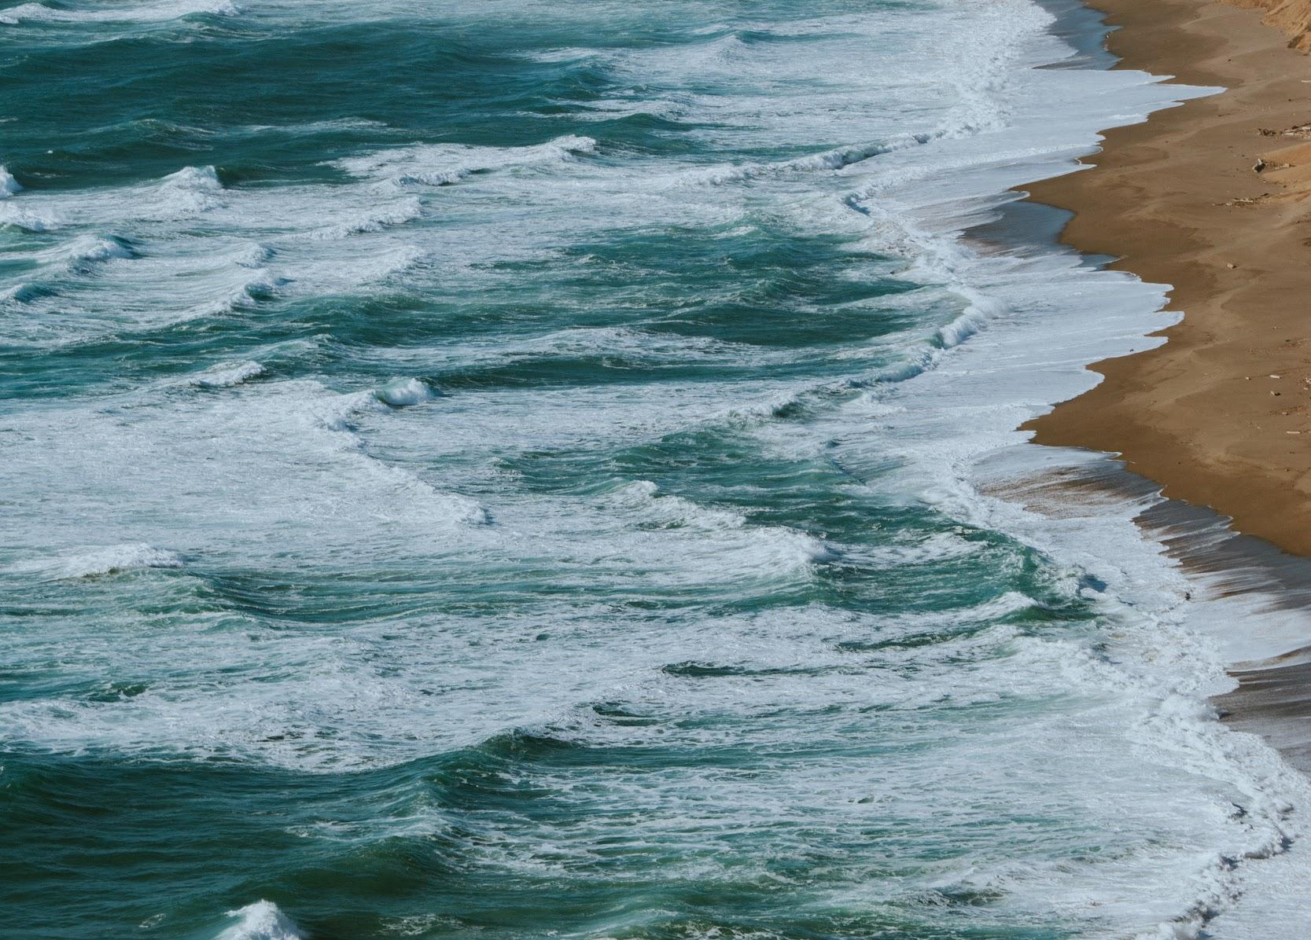
Adaptation
How do we cope as effectively as possible with the climate changes that can’t be avoided?
Notes:
So then, what can and should we do to adapt to climate change?
To find out what tools we might use, we ask:
How do we cope as effectively as possible with the climate changes that can’t be avoided?
Citation:
Copyright-free photo by Ivana Cajina on Unsplash

Slide 7
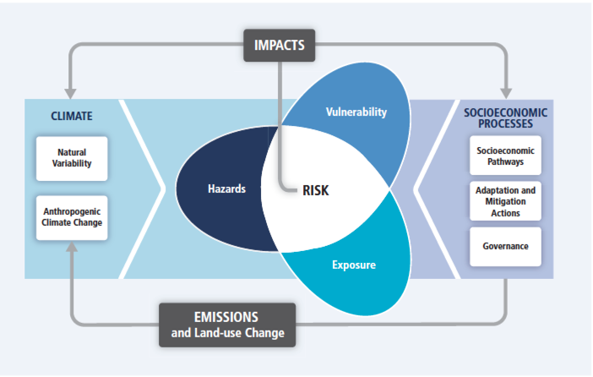
(Human-caused)
Notes:
This graphic shows where risk comes from and how the different parts of life connect.
Risk exists in the overlap of three factors: hazards, vulnerability, and exposure. We’ll go over examples of those in a minute.
Risk of climate-related impacts results from the interaction between climate-related hazards (including hazardous events and trends) and the vulnerability and exposure of human and natural systems.
Changes in the climate system (on the left) and decisions made as part of socioeconomic processes, including adaptation and mitigation efforts (on the right), are drivers of hazards, exposure, and vulnerability.
Citation:
IPCC. (2014). Summary for policymakers. In Climate Change 2014: Impacts, Adaptation, and Vulnerability.

Slide 8
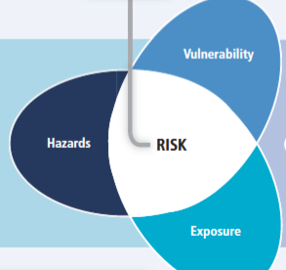
Flooding
Drought
Ocean acidification
High temperatures
Living in a subsistence community
Legacy of environmental challenges
Living in a floodplain
Living in poverty
Poor air quality
Contaminated water
Injuries from flooding
Traumatic events
Notes:
Hazards include sea level rise and extreme weather. These can be natural, manmade, or natural and made worse due to human activities.
Exposure to these hazards could mean people have poor water and air quality. It could also mean they might have to endure a traumatic event, such those in Puerto Rico living through Hurricane Maria or communities on the West Coast who have had to evacuate due to wildfires.
Those most vulnerable include subsistence communities and those who live in floodplains or who do not have the money available to leave.
The culmination of these three factors creates varying levels of risk to a community as a result of climate change.

Slide 9
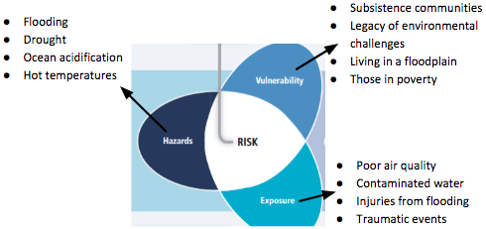
Health effects = impacts
Temperature-related illnesses and deaths
Health effects related to extreme weather events
Air pollution-related health effects
Water- and food-borne illnesses
Vector- and rodent-borne diseases
Notes:
When a vulnerable population is exposed to hazardous conditions, that exposure increases the risks and problems that the people, plants, or animals might experience.
These risks can include negative health effects.

Slide 10
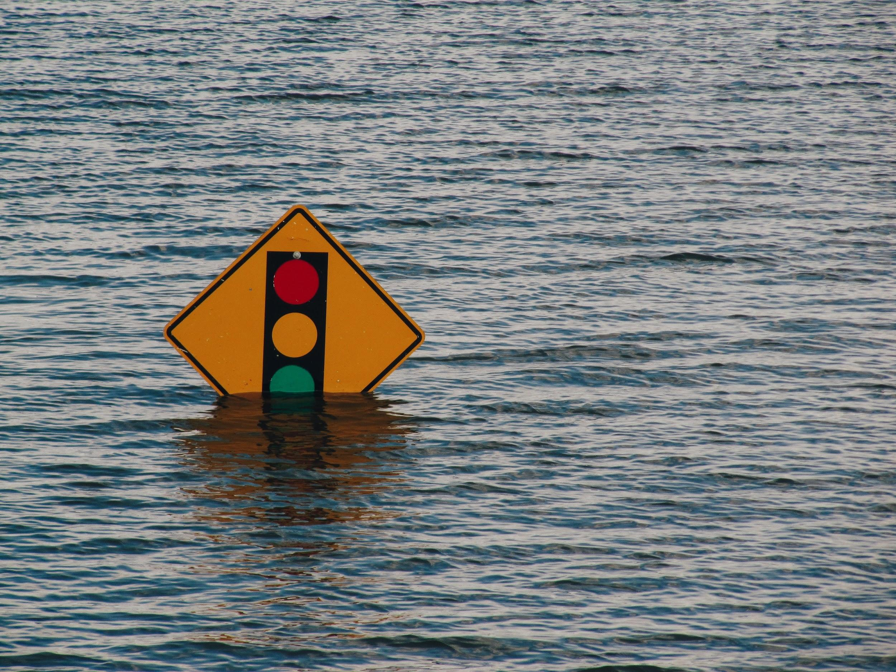
What makes the community you represent most vulnerable to the impacts of climate change?
Notes:
The term most commonly used with climate change at the community level is “vulnerability.” At regional and local levels, adaptation measures are identified by first discovering the level of vulnerability of a particular community.
Vulnerability assessments likely ask:
What makes the community you represent most vulnerable to the impacts of climate change?
Marginalization of extremely vulnerable communities can be exacerbated for communities who already suffer due to social inequalities.
This could mean small communities, rural communities, or indigenous communities.
Citations:
Petheram, L., Zander, K. K., Campbell, B. M., High, C., & Stacey, N. (2010). “Strange changes”: Indigenous perspectives of climate change and adaptation in NE Arnhem Land (Australia). Global Environmental Change, 20(4), 681–692. http://doi.org/10.1016/j.gloenvcha.2010.05.002
Copyright-free photo by Kelly Sikkema on Unsplash

Slide 11

What makes the community you represent most vulnerable to the impacts of climate change?
Living in a floodplain
Lack of knowledge about climate change
Lack of preparation
Living in a subsistence community
Legacy of environmental injustice
Elders/children
Mental health/chronic diseases
Exclusion from decision making
Unstable government
Land use policies
Water rights
Low-income homes
Resilience
Clarita Lefthand-Begay, 2015
Notes:
The responses on the left show some community responses to the question about vulnerability.
As you can see, lack of knowledge about climate impacts, lack of preparation measures, and living in a subsistence community are among the top factors named as reasons for vulnerability.
Vulnerability focuses on challenges and disadvantages that make a community or individual more likely to experience risks or hardships brought about by climate change.
Our goal today is to change our focus from vulnerability to resilience. We want to shift from thinking about overcoming disadvantages and focus our discussion on using our self-determination to succeed despite climate change.
Citations:
Valaskakis, Gail Guthrie, Stout, Madeleine Dion, & Eric Guimond. (Eds.). (2009). Restoring the balance: First nations women, community, and culture. Winnipeg, Manitoba, Canada: University of Manitoba Press.
Maru, Stafford Smith, Sparrow, Pinho, & Dube. (2014). A linked vulnerability and resilience framework for adaptation pathways in remote disadvantaged communities. Global Environmental Change, 28(C), 337-350.
Petheram, L., Zander, K. K., Campbell, B. M., High, C., & Stacey, N. (2010). “Strange changes”: Indigenous perspectives of climate change and adaptation in NE Arnhem Land (Australia). Global Environmental Change, 20(4), 681–692. http://doi.org/10.1016/j.gloenvcha.2010.05.002

Slide 12
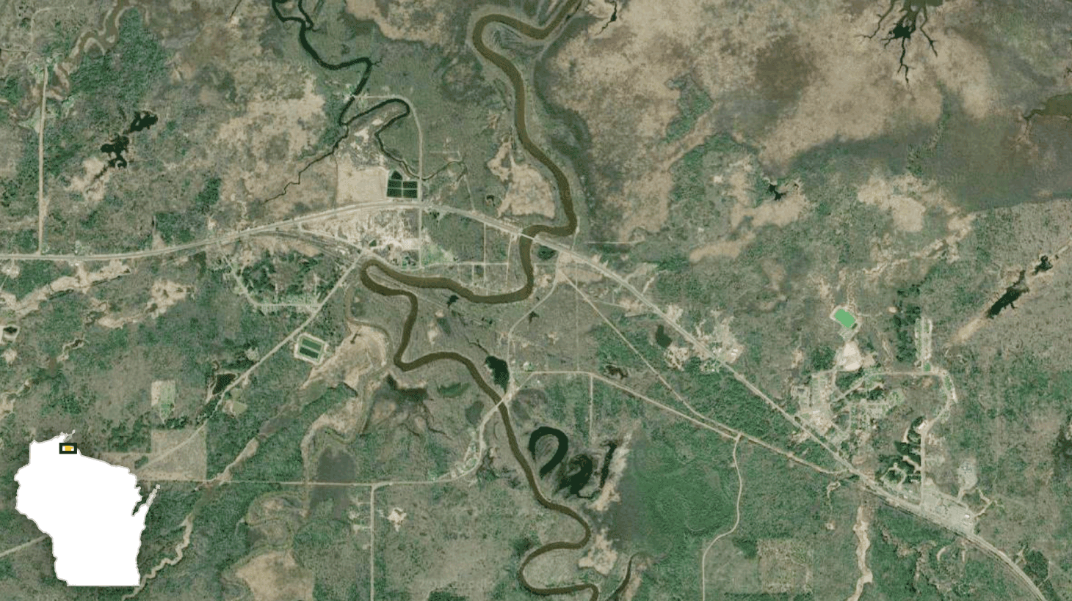
Floodplains
Original site
Current site
Odanah, WI, was built in the middle of a floodplain.
The town moved gradually out of the floodplain.
In 2016, there was a devastating flood.
The town and residents were safe.
Notes:
In previous modules, we have spoken about the Quinault Indian Nation’s relocation of their communities due to fear of climate change. They are not the only ones moving.
Odanah, WI, is located on a reservation, and the original town location was vulnerable to floods. Because it was on the floodplain, the town experienced many floods in the 1960s.
Members of the community slowly started to move their homes and buildings out of the floodplain.
This movement wasn’t due to fears of climate change, but it turned out to be a smart move.
In 2016, the river near the town flooded and would have devastated the town’s original location.
Experts estimate hundreds of buildings were saved because of the previous moves to a higher location.
There are also indigenous communities in Alaska and Louisiana that are looking to move or have already started to relocate their communities due to the vulnerability of living in a floodplain.
Citation:
Hersher, R. (2018, August 15). Wisconsin reservation offers a climate success story and a warning [radio broadcast]. Retrieved August 18, 2018, from https://www.npr.org/2018/08/15/632335735/wisconsin-reservation-offers-a-climate-success-story-and-a-warning

Slide 13

What makes the [tribal name here] community most RESILIENT to the impacts of climate change?
Priority #1: Mandatory workshops
  Start with leaders.
  Ask youth and elders.
  Gain acceptance by tribal council.
  Use workshops to make steps to change policies.
Resilience
the ability to deal with a hazardous event
comments from the Nisqually Workshop
on Dec. 12, 2016
Notes:
Here we use the definition of resiliency from Petherem: Resilience is the capacity of social, economic, and environmental systems to cope with a hazardous event or trend or disturbance, responding or reorganizing in ways that maintain their essential function, identity, and structure, while also maintaining the capacity for adaptation, learning, and transformation.
In other words→ The ability to deal with a hazardous event
In this slide, we see some examples of community-identified tools and strategies to make them resilient to climate change, including activities for community education and youth engagement.
Their first priority was to have mandatory workshops for important local leaders, making sure the workshops were approved by the tribal council and involved both their youth and elders.

Slide 14
What makes the [tribal name here] community most RESILIENT to the impacts of climate change?
Priority #2: Public education community dinners
  Ask for speaking time at planned dinners.
  Introduce climate change to communities.
  Have materials for people to take home.
  Create a slideshow video of positive actions in the community and negative impacts.
Resilience
the ability to deal with a hazardous event
comments from the
Nisqually Workshop
on Dec. 12, 2016
Notes:
Their second priority was bringing the ideas that the leaders and workshops had developed into the community.
They wanted to make sure people were given the information in different ways, so they suggested handouts and slideshows or videos along with multiple public speaking opportunities.

Slide 15
What makes the [tribal name here] community most RESILIENT to the impacts of climate change?
Priority #3: Educating youth and community about tribal rights
  Incorporate into workshops.
  Figure out how to articulate tribal treaty rights to non-tribal entities.
Priority #4: Investing in green infrastructure
Resilience
the ability to deal with a hazardous event
comments from the
Nisqually Workshop
on Dec. 12, 2016
Notes:
Finally, their last two priorities were to educate their youth and community about tribal rights and work on green infrastructure.
If the community is knowledgeable about tribal rights, they will have the power to know what changes or laws they can make for their own communities.
Also, by investing in green infrastructure, such as solar or wind generators, they’re thinking about their future and what is best for their community.
In our breakout sessions today, we will work together to answer the question: What makes the [tribal name here] community most resilient to the impacts of climate change?

Slide 16
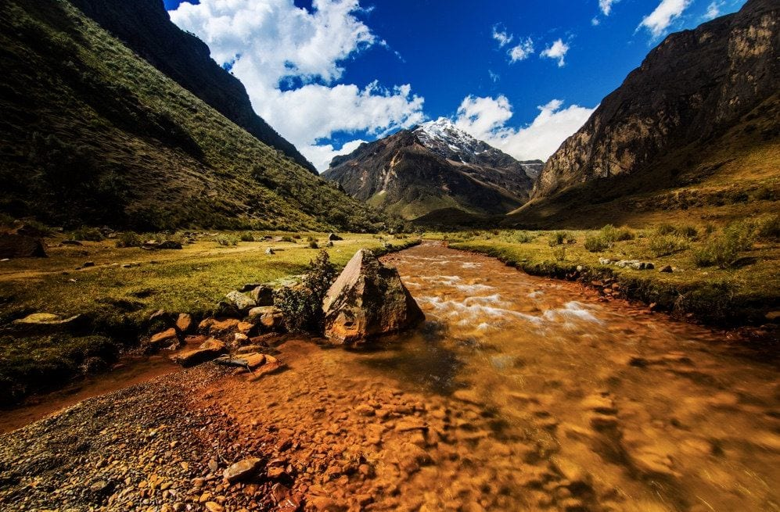
Peru
Loss of glaciers led to metal increases in rivers.
Indigenous local plant knowledge and scientific research offered a solution.
Notes:
There are many examples of indigenous groups using traditional knowledge to help their communities remain resilient to climate change.
One example is various mountain communities in Peru. A river traditionally used for water became unusable due to high levels of metals that were released into the water as the glaciers melted.
The communities partnered with local university scientists to build water purification systems consisting of ponds and local plants to clean the water and remove the metals.
Once the water was filtered through the plants and the ponds and arrived in the river, it was clean enough for humans and animals to use it again.
To learn more about this effort, please look into the nonprofit group The Mountain Institute.
Citation:
Recharte, J. (2017, December 06). These indigenous communities are models for how to adapt to climate change. The Washington Post. Retrieved August 13, 2018, from https://www.washingtonpost.com/news/theworldpost/wp/2017/12/06/climate-change-glaciers/?noredirect=on&utm_term=.4636bdf5ad05

Slide 17
Insert a local or regional example of resiliency here.

Slide 18
References
Dalton, M., Mote, P.W., & Snover, A.K. (Eds.). (2013). Climate change in the Northwest: Implications for our landscapes, waters, and communities. Washington, D.C.: Island Press.
Gautam, M. R., Chief, K., & Smith, W. J. (2013). Climate change in arid lands and Native American socioeconomic vulnerability: The case of the Pyramid Lake Paiute Tribe. Climatic Change, 120(3), 585-599.
Hersher, R. (2018, August 15). Wisconsin reservation offers a climate success story and a warning [radio broadcast]. Retrieved August 18, 2018, from https://www.npr.org/2018/08/15/632335735/wisconsin-reservation-offers-a-climate-success-story-and-a-warning
IPCC. (2014). Summary for policymakers. In Climate Change 2014: Impacts, Adaptation, and Vulnerability.
Maru, Stafford Smith, Sparrow, Pinho, & Dube. (2014). A linked vulnerability and resilience framework for adaptation pathways in remote disadvantaged communities. Global Environmental Change, 28(C), 337-350.

Slide 19
References
Patz, J. A., McGeehin, M. A., Bernard, S. M., Ebi, K. L., Epstein, P. R., Grambsch, A., … Trtanj, J. (2000). The potential health impacts of climate variability and change for the United States: executive summary of the report of the health sector of the U.S. National Assessment. Environmental Health Perspectives, 108(4), 367–376.
Petheram, L., Zander, K. K., Campbell, B. M., High, C., & Stacey, N. (2010). “Strange changes”: Indigenous perspectives of climate change and adaptation in NE Arnhem Land (Australia). Global Environmental Change, 20(4), 681–692. http://doi.org/10.1016/j.gloenvcha.2010.05.002
Recharte, J. (2017, December 06). These indigenous communities are models for how to adapt to climate change. The Washington Post. Retrieved August 13, 2018, from https://www.washingtonpost.com/news/theworldpost/wp/2017/12/06/climate-change-glaciers/?noredirect=on&utm_term=.4636bdf5ad05

Slide 20
References
Valaskakis, Gail Guthrie, Stout, Madeleine Dion, & Eric Guimond. (Eds.). (2009). Restoring the balance: First nations women, community, and culture. Winnipeg, Manitoba, Canada: University of Manitoba Press.
Yiheyis Taddele Maru, et al. (2014). A Linked Vulnerability and Resilience Framework for Adaptation Pathways in Remote Disadvantaged Communities. In Global Environmental Change, 28: 337–50.

